Slide 1
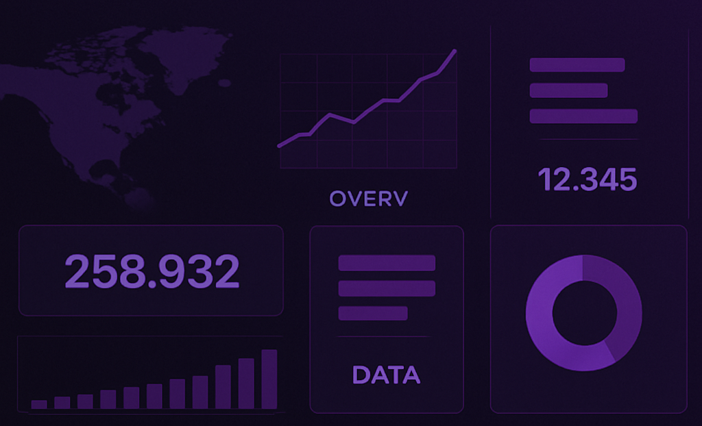
Interactive Dashboard on Covid-19 using Flex Dashboard

Slide 2
Plotly is an open-source graphing library that enables the creation of interactive, web-based visualizations. It is built on top of JavaScript's D3.js, HTML, and CSS, but with R bindings via the plotly package.it supports wide range of charts ,3d plots and dashboard.
# Key Features
Zoom, pan, and select directly in plots. Interactive hover tooltips. Built-in legends and filtering. Can convert ggplot2 plots into interactive plots using ggplotly()

Slide 3
A Flexdashboard in R is a type of interactive web dashboard created using R Markdown and the flexdashboard package. It allows you to create dashboards that are visually appealing, responsive, and can include R visualizations and interactive elements.
Key Features of Flexdashboard Built using R Markdown :
Easy to structure with sections, columns, and rows.
Integrates seamlessly with Shiny to add interactivity.
Supports HTML widgets like plotly, leaflet, DT, and others.
Mobile responsive and can be published online (e.g., RPubs, ShinyApps.io).

Slide 4
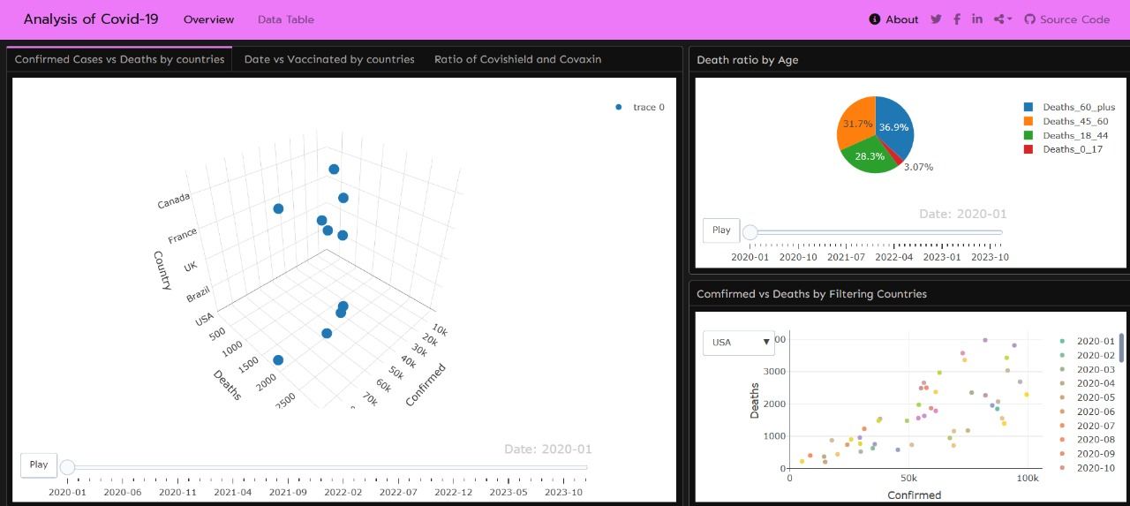
Confirmed Cases vs Death by Countries over the Years using scatter3d
Death ratio by Age over the years using Pie chart
Confirmed vs Death By filtering Countries using scatter

Slide 5
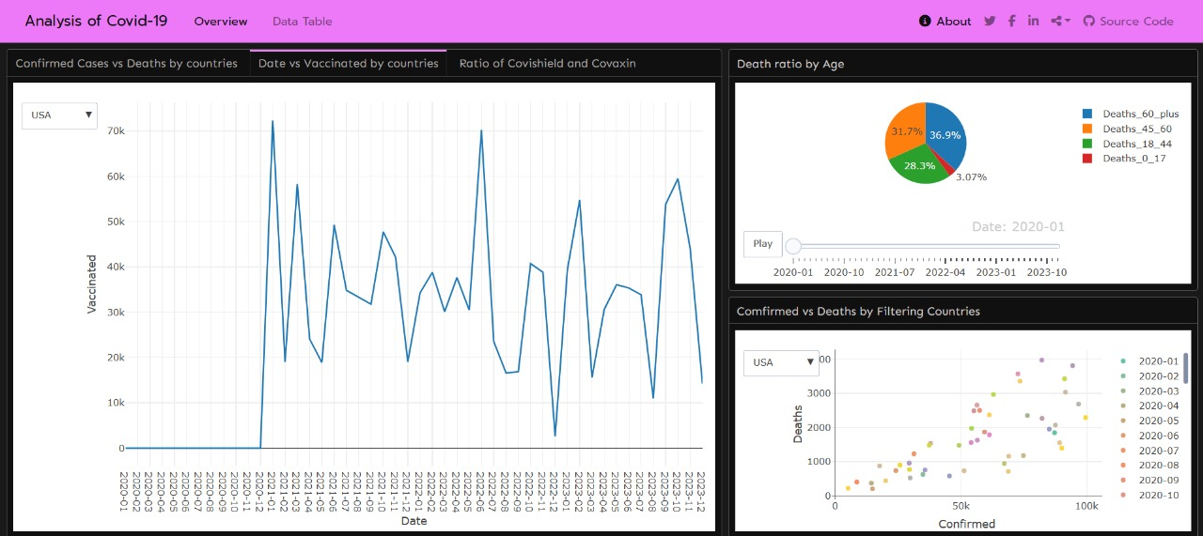
Confirmed Cases vs Death by Countries over the Years using scatter3d
Death ratio by Age over the years using Pie chart
Confirmed vs Death By filtering Countries using scatter

Slide 6
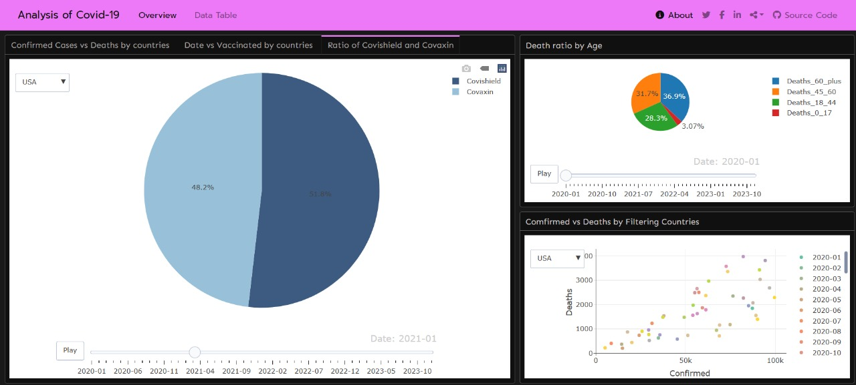
Ratio of Covaxin and Covishield
Death ratio by Age over the years using Pie chart
Confirmed vs Death By filtering Countries using scatter

Slide 7
Common methods used for graph making
plot_ly : It is an open source graphing library used for making interactive graphs.
type : It is used to define the type of chart i.e, scatter3d, scatter, pie etc.
mode : It defines how the data is visually represented in plot whether as points ,lines or combination of these elements.
color : It is used to color the graph for a group
frame : It is used to provide a slider based on a grouping variable
filter : It is used to filter rows of a data based on specific conditions

Slide 8
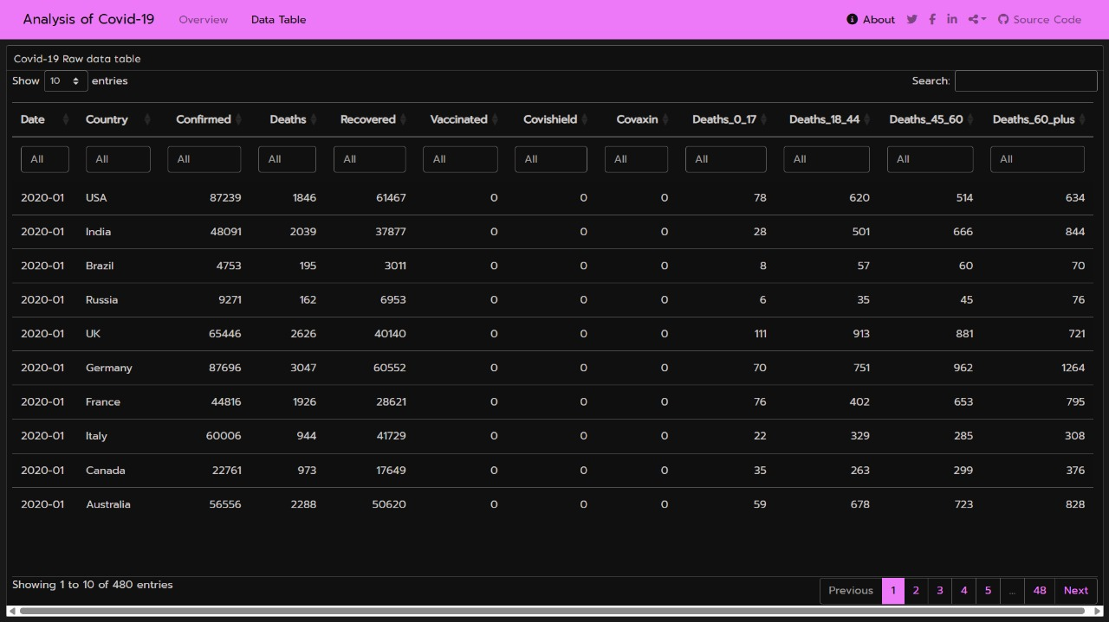
Covid_19 Dataset used for Dashboard

Slide 9
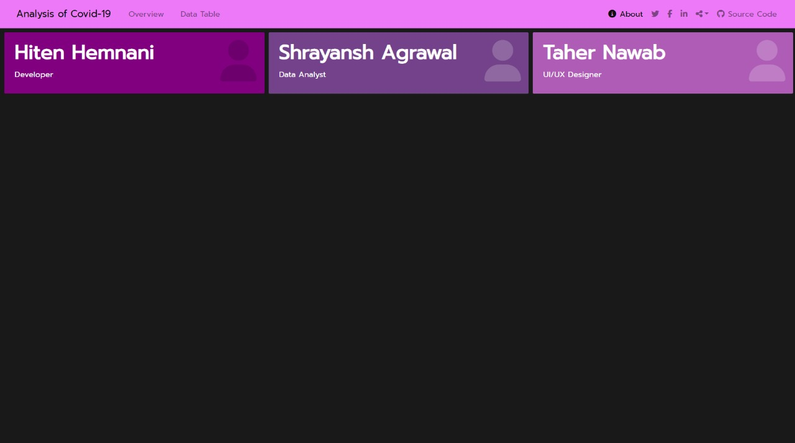
Thank
You

